Slide 1
Visual Noise Reduction: Design Verification and Validation
Evan Wilder, Matt Kramer, and Evan Kwok

Slide 2
Outline
Updates to project scope, design requirements, etc.
Plan for design verification
Plan for design validation
Results of proof of concept testing
Project update

Slide 3
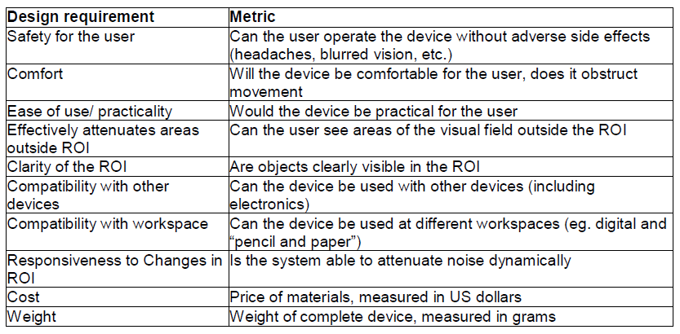
Updated Design Requirements

Slide 4
Design Verification
Safety testing of PDLC film
Testing of attenuation ability and clarity with photoresistor
Testing of responsiveness using servo motor and mechanical arm

Slide 5
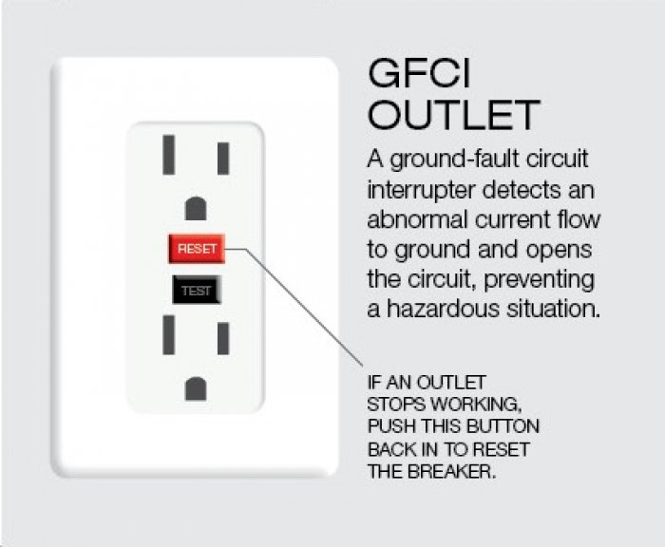
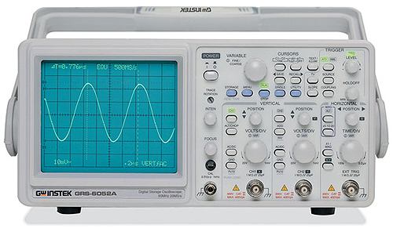
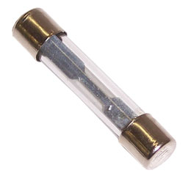
Safety testing of PDLC film

Slide 6


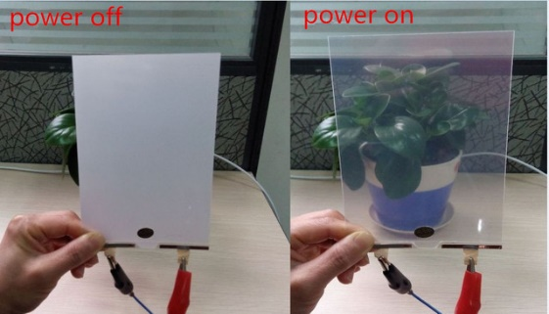
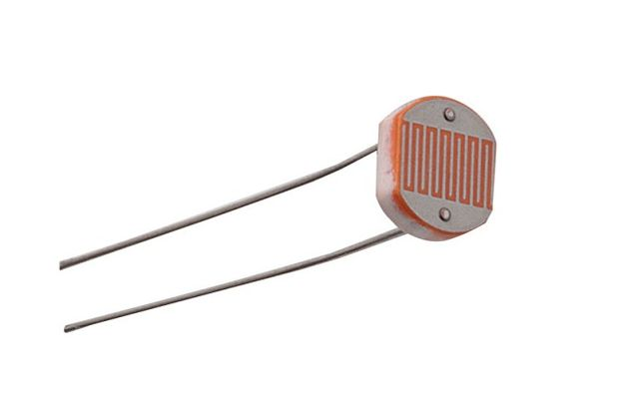
Testing attenuation ability and clarity

Slide 7
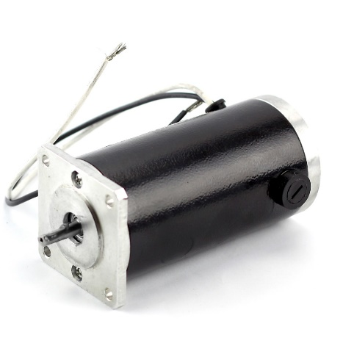
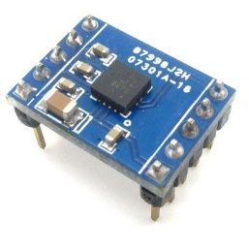
Testing of responsiveness

Slide 8
Design Validation
Control work period
Work for five minutes each on handwritten, reading, and computer tasks
Abrupt head movements
Identifying object inside and outside ROI
Rate overall device performance

Slide 9
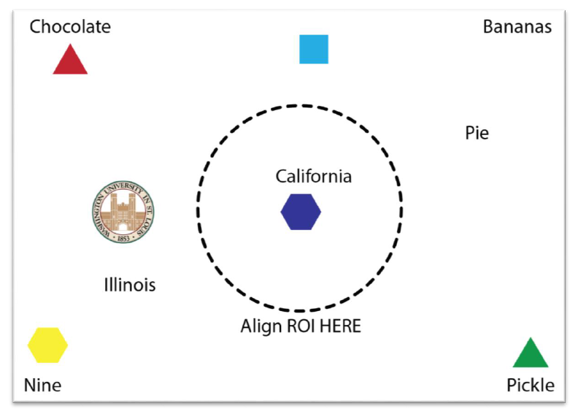

Slide 10

Proof of Concept Testing
Can the PDLC impair vision?
Can the PDLC film reliably turn on and off?
Can the accelerometer power an LED in response to accelerometer data?

Slide 11

Overall Status of the Project

Slide 12
Questions?

