Slide 1
progress report Visual Noise Reduction
By: Matt Kramer, Evan Wilder, Evan Kwok
Notes:
Remind about the project

Slide 2
Scope Changes
Project will focus mainly on attenuation of unwanted visual stimuli
In order to:
Create a more robust system
Maintain timeline of the class
Need Statement remains unchanged
Attenuation
Detection
Design
Notes:
Highest likelihood of success with the project comes with maximizing for one variable

Slide 3
Design Specs Changes
Removed Specs
Added Specs
Dynamic response
Ease of troubleshooting
Ease of setup
Accuracy in defining region of interest(ROI)
Responsiveness to changes in region of interest
No Schedule or team responsibility changes

Slide 4
Design alternatives

Slide 5
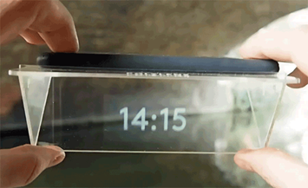
Self made Augmented reality(AR)
Main Features: Plastic Visor, Phone App
Visor: 4 laser cut pieces of plastic
App: Software development
Phone projects image into the field of view
black light would be projected around the region of interest(ROI)
This projection attenuates the visual noise

Slide 6
Commercial aR
Similar idea for attenuation as the homemade AR system
Placement of black light in visual field
Improvement on attenuation
Improves on fundamental issues of a homemade AR
BUT at what cost??
Appeal: systems typically have software developer kits (SDK)
Large communities of platform developers
Full Virtual Reality is even further out of the price range so I will move on

Slide 7
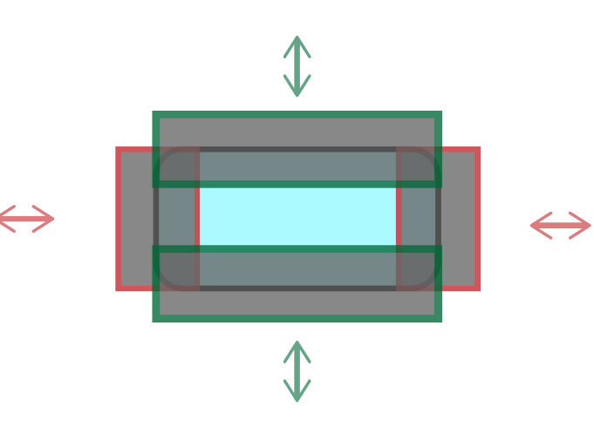
Manual Blocking: shields
First of two solutions that physically blocks the user’s visual
Adds on to an eye glass form
Involves 4 opaque “shields” per lens
Slide in pairs, top/bottom and right/left
Either manual movement or servo
Left and right lens will be synchronized
User adjustment of the visual field
Rectangular field of view

Slide 8
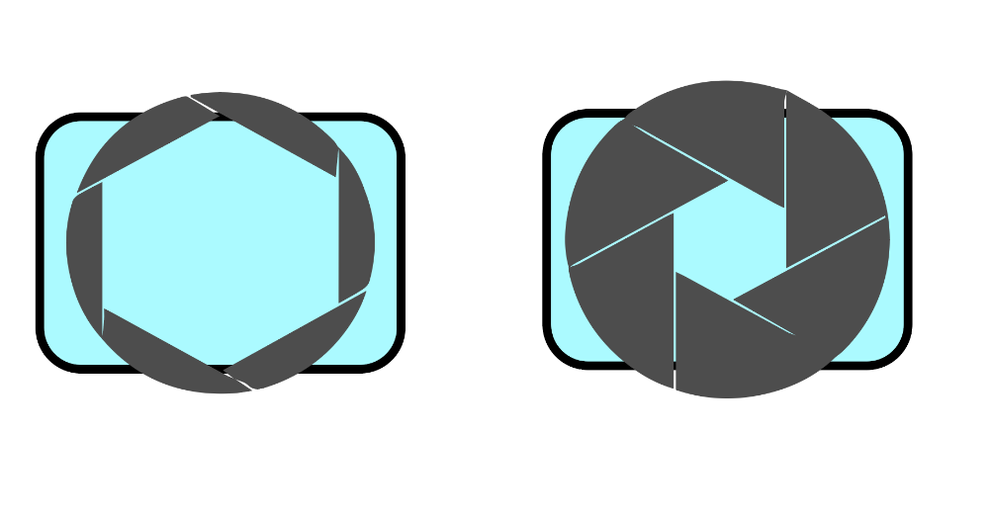
Manual Blocking: Aperture
Second manual blocking solution
Frame will be 3D printed and parted with an aperture mechanism
Similar to a camera aperture
Rotation in one direction narrows the ROI and an opposite turn widens the ROI
Overlapping blades attenuates outside the user’s ROI
Circular field of view

Slide 9
Polymer dispersed light crystal(PDLC) glass with accelerometer
PDLC is two thin layers of glass with an opaque polymer in between
Without a potential, PDLC is opaque
With a potential, PDLC is clear
Off glasses form
PDLC layers glass lenses with circular hole
Pairing PDLC with an accelerometer
Holding head still blocks outside a predefined, circular ROI
Moving head, allows for full visual field
Circular field of view

Slide 10
Pugh Analysis
Design requirement | Weight | Homemade AR | Commercial AR | Commercial VR | Smart glass with accelerometer | Manual blocking “shields” | Manual blocking aperture
Safety for the user | 10 | 10 | 10 | 6 | 10 | 7 | 7
Comfort | 7 | 5 | 8 | 7 | 6 | 6 | 6
Ease of use/ practicality | 7 | 6 | 7 | 3 | 7 | 4 | 5
Effectively attenuates areas outside ROI | 8 | 3 | 6 | 10 | 9 | 10 | 10
Clarity of the ROI | 9 | 10 | 10 | 6 | 10 | 10 | 10
Compatibility with other devices | 7 | 6 | 5 | 4 | 10 | 10 | 10
Compatibility with workspace | 6 | 10 | 10 | 5 | 10 | 10 | 10
Responsiveness to Changes in ROI | 8 | 9 | 9 | 2 | 9 | 3 | 2
Portability | 6 | 8 | 7 | 2 | 10 | 10 | 10
Cost | 8 | 10 | 2 | 1 | 6 | 10 | 10
Battery life | 7 | 6 | 8 | 4 | 10 | 10 | 10
Device weight | 4 | 5 | 7 | 2 | 7 | 7 | 10
Total |  | 655 | 652 | 394 | 761 | 702 | 713
Design requirement | Weight | Homemade AR | Commercial AR | Commercial VR | Smart glass with accelerometer | Manual blocking “shields” | Manual blocking aperture
Safety for the user | 10 | 10 | 10 | 6 | 10 | 7 | 7
Comfort | 7 | 5 | 8 | 7 | 6 | 6 | 6
Ease of use/ practicality | 7 | 6 | 7 | 3 | 7 | 4 | 5
Effectively attenuates areas outside ROI | 8 | 3 | 6 | 10 | 9 | 10 | 10
Clarity of the ROI | 9 | 10 | 10 | 6 | 10 | 10 | 10
Compatibility with other devices | 7 | 6 | 5 | 4 | 10 | 10 | 10
Compatibility with workspace | 6 | 10 | 10 | 5 | 10 | 10 | 10
Responsiveness to Changes in ROI | 8 | 9 | 9 | 2 | 9 | 3 | 2
Portability | 6 | 8 | 7 | 2 | 10 | 10 | 10
Cost | 8 | 10 | 2 | 1 | 6 | 10 | 10
Battery life | 7 | 6 | 8 | 4 | 10 | 10 | 10
Device weight | 4 | 5 | 7 | 2 | 7 | 7 | 10
Total | 87 | 655 | 652 | 394 | 761 | 702 | 713
Normalized Average Rating |  | 7.5287356 | 7.49425 | 4.52874 | 8.74713 | 8.06897 | 8.1954

Slide 11
Pugh Analysis
Design requirement | Weight | Homemade AR | Commercial AR | Commercial VR | Smart glass with accelerometer | Manual blocking “shields” | Manual blocking aperture
Safety for the user | 10 | 10 | 10 | 6 | 10 | 7 | 7
Comfort | 7 | 5 | 8 | 7 | 6 | 6 | 6
Ease of use/ practicality | 7 | 6 | 7 | 3 | 7 | 4 | 5
Effectively attenuates areas outside ROI | 8 | 3 | 6 | 10 | 9 | 10 | 10
Clarity of the ROI | 9 | 10 | 10 | 6 | 10 | 10 | 10
Compatibility with other devices | 7 | 6 | 5 | 4 | 10 | 10 | 10
Compatibility with workspace | 6 | 10 | 10 | 5 | 10 | 10 | 10
Responsiveness to Changes in ROI | 8 | 9 | 9 | 2 | 9 | 3 | 2
Portability | 6 | 8 | 7 | 2 | 10 | 10 | 10
Cost | 8 | 10 | 2 | 1 | 6 | 10 | 10
Battery life | 7 | 6 | 8 | 4 | 10 | 10 | 10
Device weight | 4 | 5 | 7 | 2 | 7 | 7 | 10
Total |  | 655 | 652 | 394 | 761 | 702 | 713
Design requirement | Weight | Homemade AR | Commercial AR | Commercial VR | Smart glass with accelerometer | Manual blocking “shields” | Manual blocking aperture
Safety for the user | 10 | 10 | 10 | 6 | 10 | 7 | 7
Comfort | 7 | 5 | 8 | 7 | 6 | 6 | 6
Ease of use/ practicality | 7 | 6 | 7 | 3 | 7 | 4 | 5
Effectively attenuates areas outside ROI | 8 | 3 | 6 | 10 | 9 | 10 | 10
Clarity of the ROI | 9 | 10 | 10 | 6 | 10 | 10 | 10
Compatibility with other devices | 7 | 6 | 5 | 4 | 10 | 10 | 10
Compatibility with workspace | 6 | 10 | 10 | 5 | 10 | 10 | 10
Responsiveness to Changes in ROI | 8 | 9 | 9 | 2 | 9 | 3 | 2
Portability | 6 | 8 | 7 | 2 | 10 | 10 | 10
Cost | 8 | 10 | 2 | 1 | 6 | 10 | 10
Battery life | 7 | 6 | 8 | 4 | 10 | 10 | 10
Device weight | 4 | 5 | 7 | 2 | 7 | 7 | 10
Total | 87 | 655 | 652 | 394 | 761 | 702 | 713
Normalized Average Rating |  | 7.5287356 | 7.49425 | 4.52874 | 8.74713 | 8.06897 | 8.1954

Slide 12
Pugh Analysis
Design requirement | Weight | Homemade AR | Commercial AR | Commercial VR | Smart glass with accelerometer | Manual blocking “shields” | Manual blocking aperture
Safety for the user | 10 | 10 | 10 | 6 | 10 | 7 | 7
Comfort | 7 | 5 | 8 | 7 | 6 | 6 | 6
Ease of use/ practicality | 7 | 6 | 7 | 3 | 7 | 4 | 5
Effectively attenuates areas outside ROI | 8 | 3 | 6 | 10 | 9 | 10 | 10
Clarity of the ROI | 9 | 10 | 10 | 6 | 10 | 10 | 10
Compatibility with other devices | 7 | 6 | 5 | 4 | 10 | 10 | 10
Compatibility with workspace | 6 | 10 | 10 | 5 | 10 | 10 | 10
Responsiveness to Changes in ROI | 8 | 9 | 9 | 2 | 9 | 3 | 2
Portability | 6 | 8 | 7 | 2 | 10 | 10 | 10
Cost | 8 | 10 | 2 | 1 | 6 | 10 | 10
Battery life | 7 | 6 | 8 | 4 | 10 | 10 | 10
Device weight | 4 | 5 | 7 | 2 | 7 | 7 | 10
Total |  | 655 | 652 | 394 | 761 | 702 | 713
Design requirement | Weight | Homemade AR | Commercial AR | Commercial VR | Smart glass with accelerometer | Manual blocking “shields” | Manual blocking aperture
Safety for the user | 10 | 10 | 10 | 6 | 10 | 7 | 7
Comfort | 7 | 5 | 8 | 7 | 6 | 6 | 6
Ease of use/ practicality | 7 | 6 | 7 | 3 | 7 | 4 | 5
Effectively attenuates areas outside ROI | 8 | 3 | 6 | 10 | 9 | 10 | 10
Clarity of the ROI | 9 | 10 | 10 | 6 | 10 | 10 | 10
Compatibility with other devices | 7 | 6 | 5 | 4 | 10 | 10 | 10
Compatibility with workspace | 6 | 10 | 10 | 5 | 10 | 10 | 10
Responsiveness to Changes in ROI | 8 | 9 | 9 | 2 | 9 | 3 | 2
Portability | 6 | 8 | 7 | 2 | 10 | 10 | 10
Cost | 8 | 10 | 2 | 1 | 6 | 10 | 10
Battery life | 7 | 6 | 8 | 4 | 10 | 10 | 10
Device weight | 4 | 5 | 7 | 2 | 7 | 7 | 10
Total | 87 | 655 | 652 | 394 | 761 | 702 | 713
Normalized Average Rating |  | 7.5287356 | 7.49425 | 4.52874 | 8.74713 | 8.06897 | 8.1954
Notes:
Mention weights – project is all about RIO

Slide 13
Chosen solution:

Slide 14
Chosen solution:
PDLC with Accelerometer
Notes:
Reminder of PDLC

Slide 15
More on PDLC with accelerometer
3D lens/frames with some resemblance to safety goggles
Accelerometer mounted closer to lenses
PDLC film will layer the lenses, with circle cut out of the center
Microcontroller connects the accelerometer to the PDLC film
Power will be supplied to the microcontroller
A large movement will apply voltage to PDLC
Lens
Accelero-
meter
PDLC film
Micro-Controller
Notes:
Reminder of PDLC film

Slide 16
More on using the solution
“Movements” result in clearing visual field
Definition of a movement is not defined
Will use accelerometer data as input
Lack of movement attenuates outside the ROI
Typically PDLC used as “on” or “off”
Can vary the opaqueness with a changing potential

Slide 17
Budget
PDLC Film $200
Microcontroller $50-100
Batteries $50-100
3D printed filament $20
Accelerometer $20
Unexpected Expenses (Shipping, Wiring, $200
Replacement, Parts, etc.)
Total $640

Slide 18
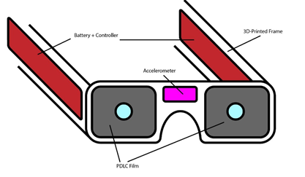
Questions?

