Slide 1
Visual Noise Reduction
Preliminary Report
Client: Zimin Hang
Matt Kramer, Evan Kwok, Evan Wilder
10/10/16

Slide 2
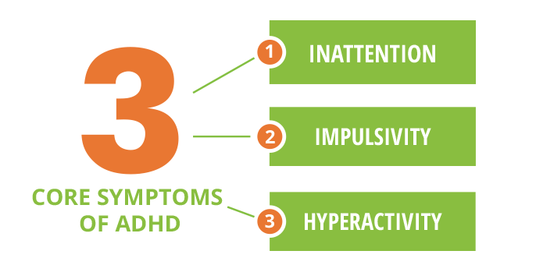
Background
Attention Deficit Activity Disorder (ADHD) is a neurological disorder characterized by: impulsivity, hyperactivity, and inattention.
Innate school and workplace disadvantages: loss of productivity, organization, speed, attention
$77 Billion lost from the US economy annually due to ADHD

Slide 3
Population
1
8 million adults with ADHD (~4.4%) in America:
only half of these adults maintain a full-time job, and of those, 43% leave due to difficulties with ADHD
18 times more likely to be disciplined for behavioral issues
60% more likely to lose their job
Earn 5,000 – 10,000 less than colleagues without ADHD
Since 1997, number of ADHD diagnoses increases ~3% annually
2
7
7
5
3

Slide 4
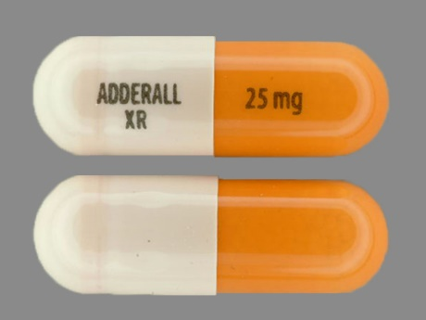
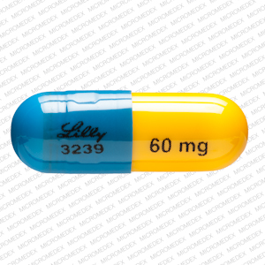
Existing Solutions
Current solutions for ADHD fall into three categories:
Stimulants
Non-Stimulants
Behavioral Therapy

Slide 5
Market
ADHD Treatment market value was $6.9 billion in 2013, and is estimated to grow to $9.9 billion by 2020
18 million cases diagnosed annually by 2020
Average treatment cost ranges between $2,000 to $17,000, per patient, annually
15
17
8

Slide 6
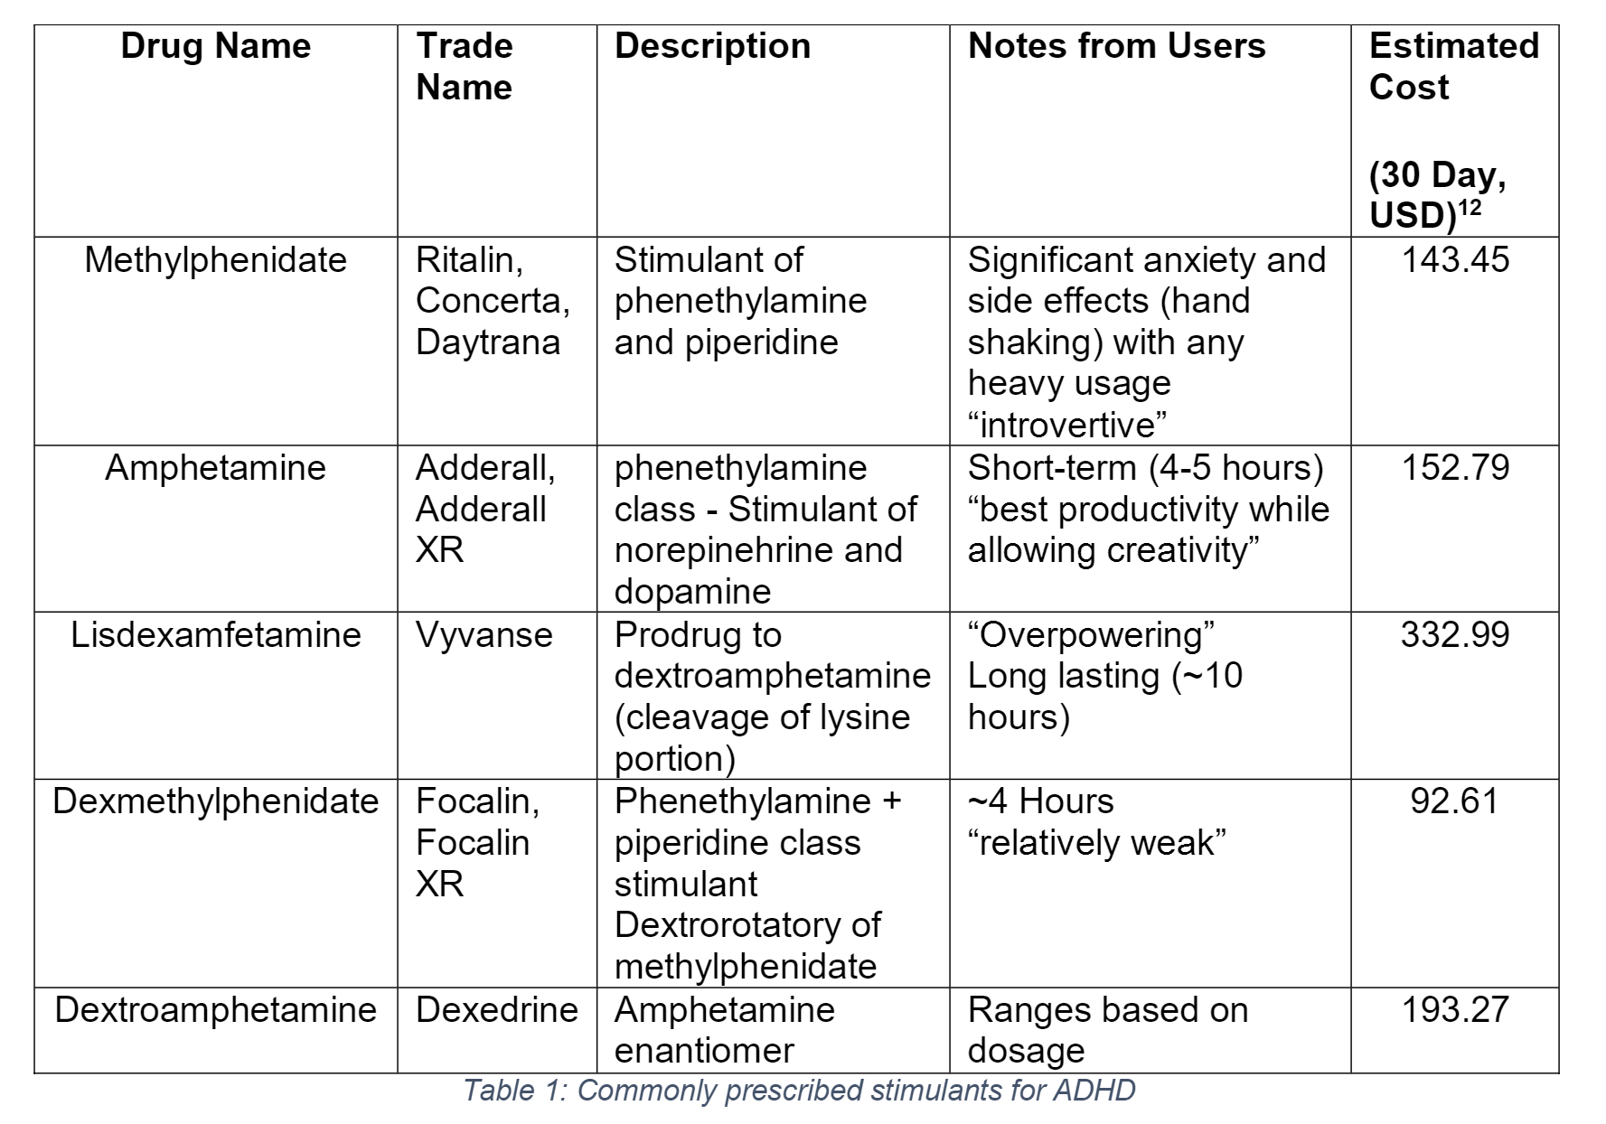
Stimulants
Stimulants are the most commonly prescribed medication for ADHD
60% of children diagnosed with ADHD are treated with stimulants
Generally increase dopamine and norepinephrine levels
Long-term risks: cardiovascular stress, amphetamine psychosis
Illicit/non-prescription use on the rise (performance-enhancing and recreational)
4

Slide 7
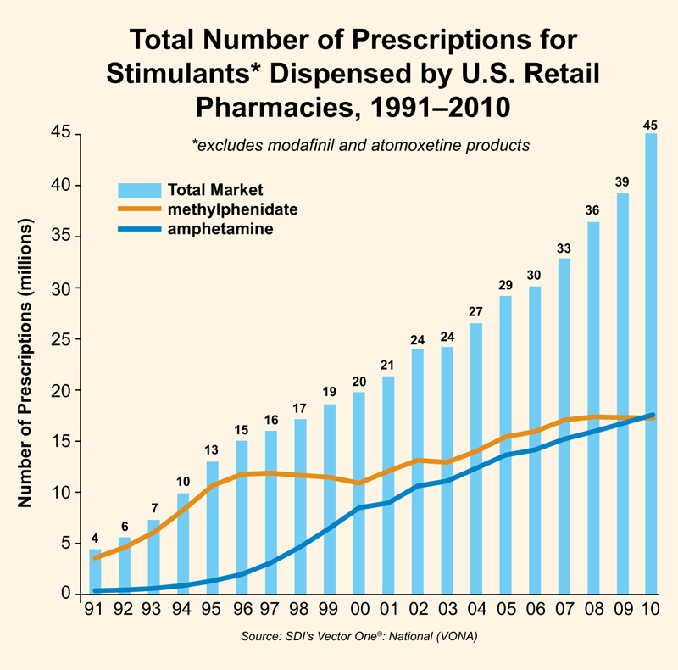
Stimulant Abuse
2/3 of college students report being offered prescription stimulants, while one-third report using one
(compared to 4.4% of American adults diagnosed ADHD)
Used both for performance-enhancing and recreational use among young adults.
25% of those being treated for alcohol and substance abuse are also on stimulant medication for ADHD
4
1
4

Slide 8
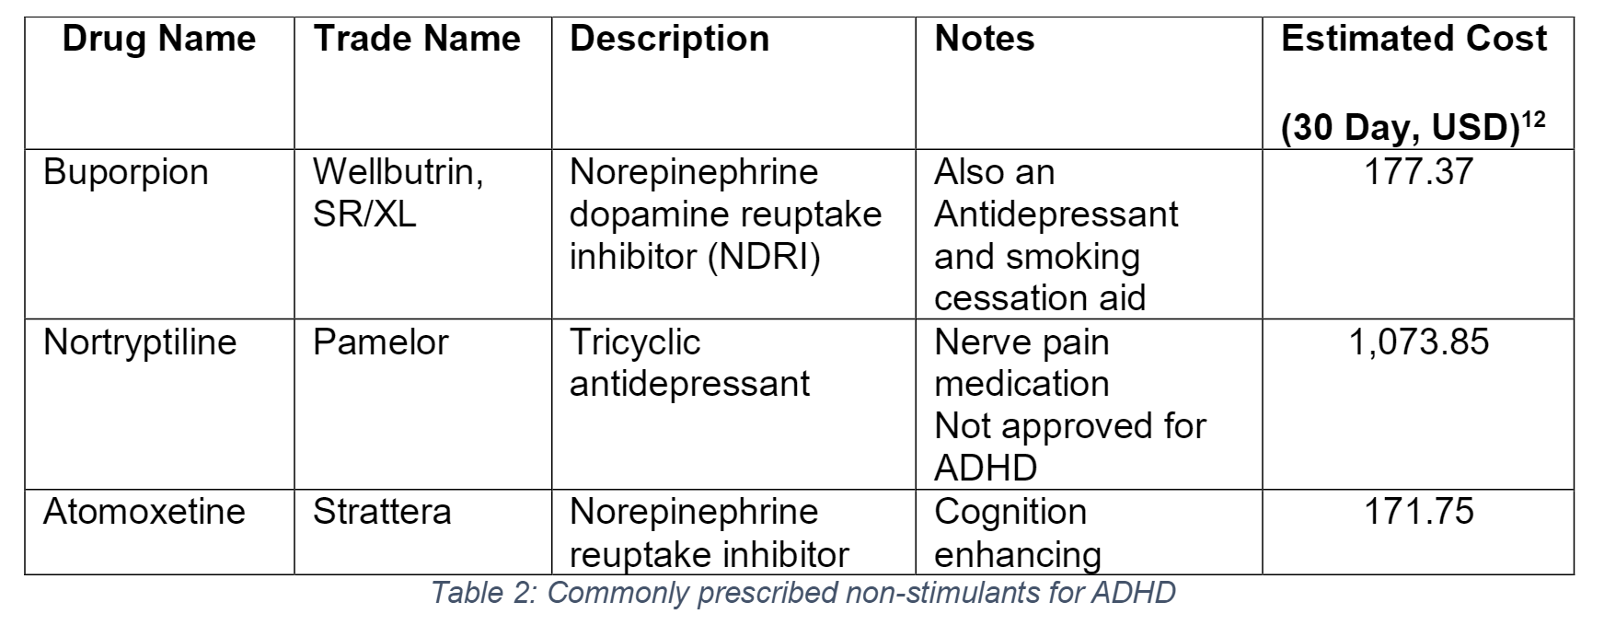
Non-Stimulants
Non-stimulants include a range of drugs (usually antidepressants, blood pressure medications) that are meant to inhibit reuptake of norepinephrine or general cognition enhancement
Effects are subtler and longer lasting than stimulants
Side effects and potential drug/diet interactions cause a serious risk

Slide 9
Research Chemicals
Illegal/Grey market drugs
No testing or validation for quality done
“Last resort” when other prescription treatment options are not effective
14

Slide 10
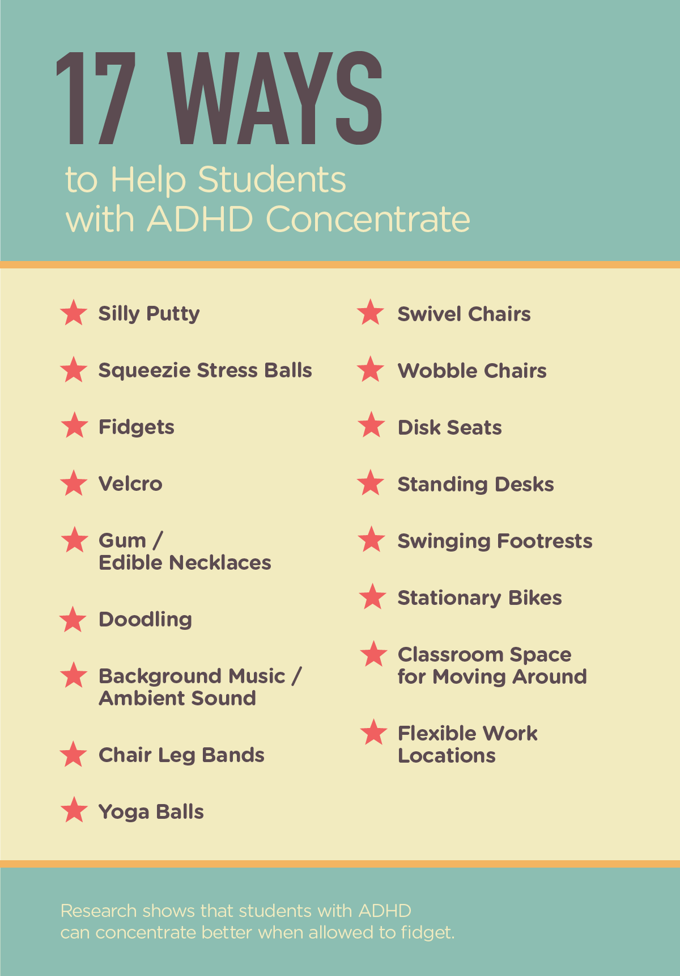
Behavioral Therapy
Techniques for behavior modification (often used in conjunction with pharmaceutical treatment)
Common Examples:
Reinforcement/Punishment
Meditation
Cognitive coaching
Other general focus techniques/strategies: Cubicles in office spaces, Noise-Cancelling headphones, Creating a routine schedule
Behavioral therapy is largely dependent on the patient, must be tailored and trained for individuals

Slide 11
Premise
18
“uncluttered” work-space increases productivity
Noise canceling headphones
Correlation between visual saccades and cognitive load
No current regulations for blocking FOV
Shatter-proof glass in eye-wear and safety gear
17
16

Slide 12
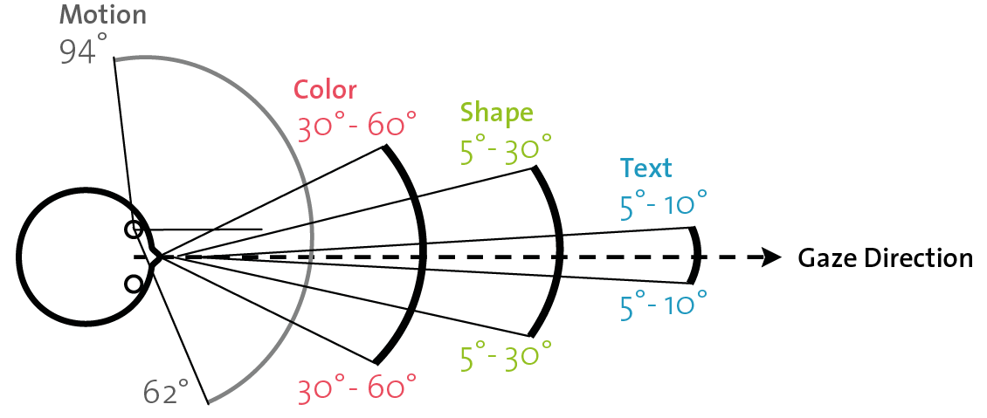
Project Scope
This project will focus on creating a way to dynamically reduce visual noise to lessen distraction for individuals with trouble focusing
Two parts:
1) Detect Region of Interest (ROI)
2) Attenuate visual stimuli outside of designated ROI

Slide 13
Proposed solution
We hope to combine the benefits of pharmaceutical treatments and behavioral therapy, while avoiding the side effects.
Inattention – patient focuses on region of interest
Impulsivity – less prone to become distracted by surroundings

Slide 14
Design Metrics
Design requirement | Metric
Safety for the user | Can the user operate the device without adverse side effects (headaches, blurred vision, etc.), measured with user feedback
Comfort | Will the device be comfortable for the user for periods ~60 minutes long, measured with user feedback
Ease of use/ practicality | Would the device be practical for the user, measured with user feedback
Dynamic response; response time/ lag | Will the system respond dynamically to changes in ROI, measured with user feedback (<1s response time)
Ease of troubleshooting | Can the user fix problems with the device without assistance, measured with user feedback
Unobtrusiveness | Does the device obstruct movement, measured with user feedback (Full range of motion for user)
Effectively attenuates areas outside ROI | Can the user see areas of the visual field outside the ROI, measured with user feedback
Clarity of the ROI | Are objects clearly visible in the ROI, measured with user feedback
Accuracy in identifying ROI | Does the device incorrectly define the ROI, measured with user feedback (>80% accuracy of ROI)
Compatibility with other devices | Can the device be used with other devices (including electronics), measured with user feedback
Compatibility with workspace | Can the device be used at different workspaces, measured with user feedback
Portability | Smaller than 0.5m^3 (Device Footprint, measured in square meters)
Cost | Price of materials <$500, measured in US dollars
Battery life | (if necessary) Must be able to operate for at least 60 minutes without external power
Weight | <200g (average eyeglass weight = 50g)
Ease of set-up | Set up time <2 minutes per session

Slide 16
Sources
"NIMH » Attention Deficit Hyperactivity Disorder." U.S National Library of Medicine. U.S. National Library of Medicine, n.d. Web. 06 Oct. 2016.
"How ADHD Affects the Workplace." MHAI.org. Mental Health America of Illinois (MHAI), n.d. Web. 6 Oct. 2016.
"Data & Statistics." Centers for Disease Control and Prevention. Centers for Disease Control and Prevention, 04 May 2016. Web. 06 Oct. 2016.
"ADHD and Substance Abuse: Alcohol and Drugs Connected to ADHD." WebMD. WebMD, n.d. Web. 06 Oct. 2016.
@adultadhd. "ADHD at Work by the Numbers." ADDA Attention Deficit Disorder Association. N.p., n.d. Web. 06 Oct. 2016.
Hilton MF, et al. “The Association Between Mental Disorders and Productivity in Treated and Untreated Employees,” Journal of Occupational and Environmental Medicine (Sept. 2009): Vol. 51, No. 9, pp. 996–1003.
Barkley, R., Murphy, K., Fischer, M. (2008). ADHD in Adults: What the Science Says. New York, Guilford Press (UMASS Study p. 279)
"NIMH » Prescribed Stimulant Use for ADHD Continues to Rise Steadily." U.S National Library of Medicine. U.S. National Library of Medicine, n.d. Web. 06 Oct. 2016.
"The Shocking Cost of Your Child's ADHD." The Fiscal Times. N.p., n.d. Web. 06 Oct. 2016.
Berman, Steven M., Ronald Kuczenski, James T. McCracken, and Edythe D. London. "Potential Adverse Effects of Amphetamine Treatment on Brain and Behavior: A Review." Molecular Psychiatry. U.S. National Library of Medicine, Feb. 2009. Web. 06 Oct. 2016.
Knouse, Laura E., and Steven A. Safren. "Current Status of Cognitive Behavioral Therapy for Adult Attention-Deficit Hyperactivity Disorder." The Psychiatric Clinics of North America. U.S. National Library of Medicine, Sept. 2010. Web. 06 Oct. 2016.
"Drug Cost Estimates - Brands." Bcbsil, n.d. Web. 6 Oct. 2016.
http://www.pleasehealthyourself.com/2013/02/18/adderall-abuse/
https://adhdselfhelp.wordpress.com/research-chemicals/
"ADHD Treatment Market Value to Reach $9.9 Billion." Drug Development and Delivery Home. GBI Research, 21 Aug. 2016. Web. 09 Oct. 2016.
Marzieh Salehi Fadardi, Larry A. Abel; The Effect Of Cognitive Load On Saccadic Charactristics. Invest. Ophthalmol. Vis. Sci. 2012;53(14):4865.
https://www.scientificamerican.com/article/ask-the-brains-background-noise/
https://www.ncbi.nlm.nih.gov/pubmed/21228167

Slide 17
Questions

